Slide 1







Programming
SESSION
By Ahmed Abubakr

Slide 2

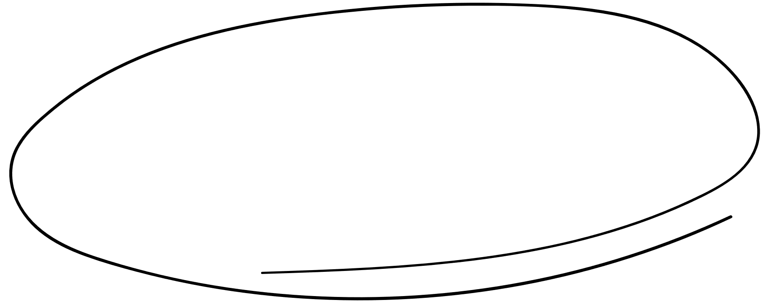

Contents
1
4
INTRODUCTION
WHAT IS PROGRAMMING
2
5
PROGRAMMING LEVELS
FIELDS OF PROGARAMMING
3
6
PROGRAMMING LANGUAGES
EXAMPLE

Slide 3



Introduction
Who Am I ?
Who Can Learn Programming ?
Why We Learn Programming ?

Slide 4



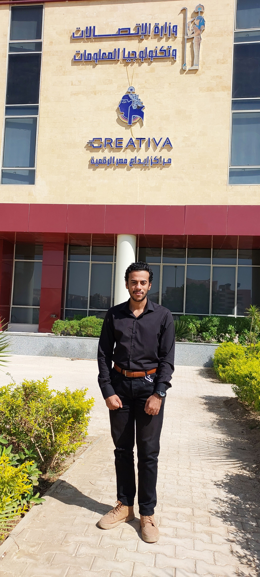

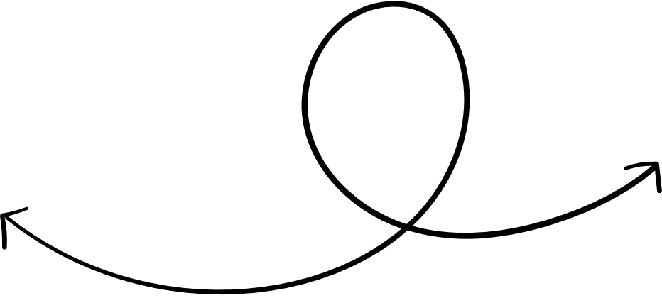


About me
Ahmed Mohamed Abubakr
Electrical Engineer
Ahmed Abubakr

Slide 5
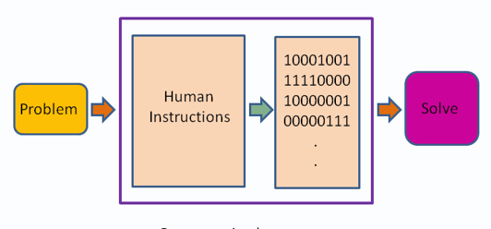
What is Programming
Writing a set of instructions that is executed by the machine to perform a specific task

Slide 6
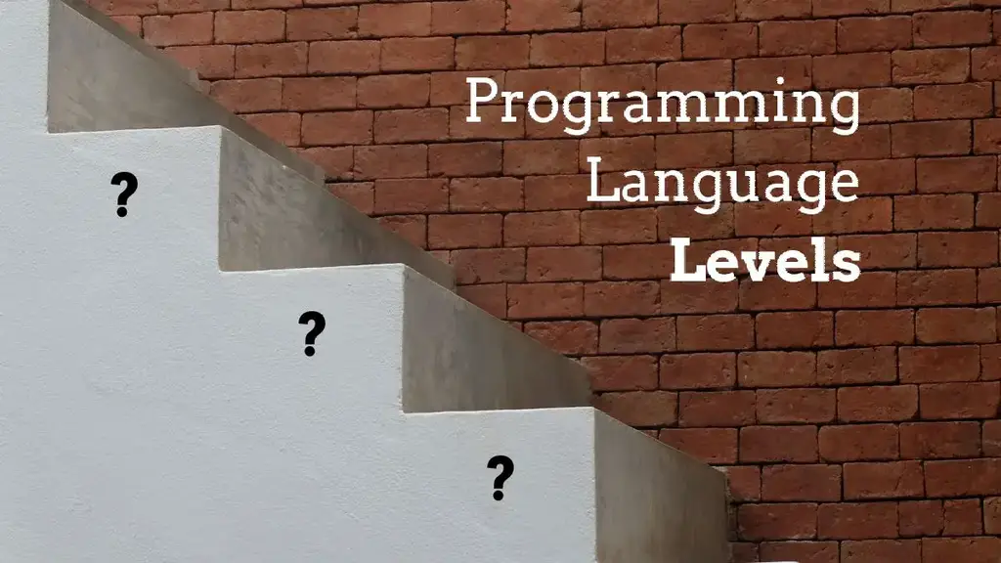

Slide 7
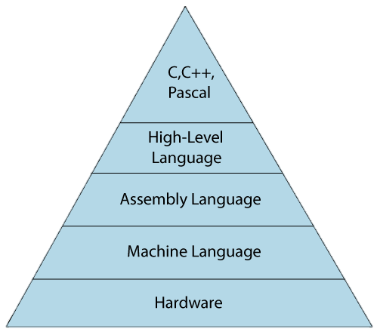
High level
Low level

Slide 8




Programming levels
Low level
High level
Machine Code and Assembly Language.
Java, Python, PHP, Perl, C#, JavaScript, etc.

Slide 9

Machine language | Assembly | High level (C++)
100010110001010111111100111111111111111111111111101000011111100011111111111111111111111100000001110100001010001111110100111111111111111111111111
mov edx, DWORD PTR [rbp-4]
mov eax, DWORD PTR [rbp-8]
add eax, edx
mov DWORD PTR [rbp-12], eax
z = x + y;

Slide 10




What is operating systems ?

Slide 11
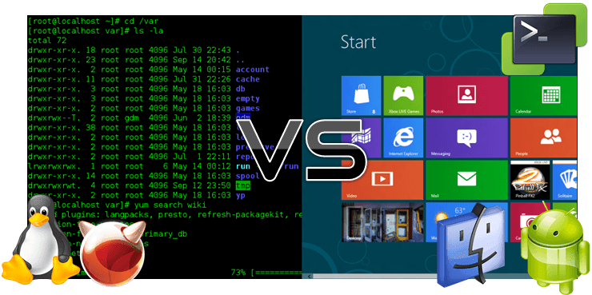
What is operating systems ?
Notes:
Get windows type (64bit – 32bit)

Slide 12
f
What is extensions ?
File.jpg
File name
extension
Dot to separate

Slide 13



Web Development
Cyber security
Desktop applications
IOT
Fields of Programming
Android Applications
AI

Slide 14
Javascript
C++
Java
Programming Languages
C#
Perl
Python
PHP

Slide 15


Example
Lets be web developers and create a website

Slide 16
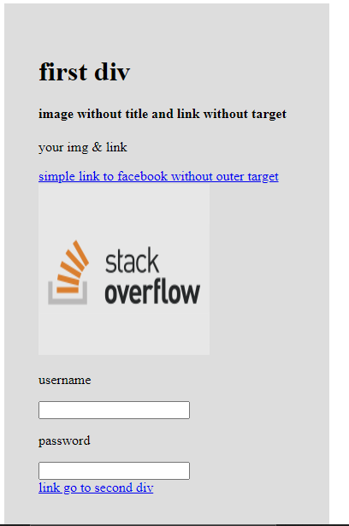
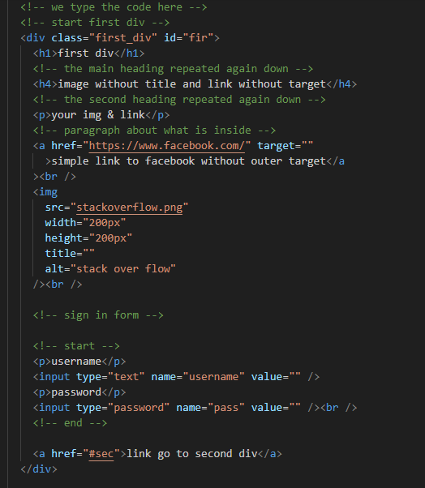
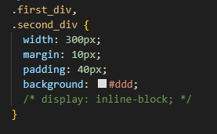

Slide 17
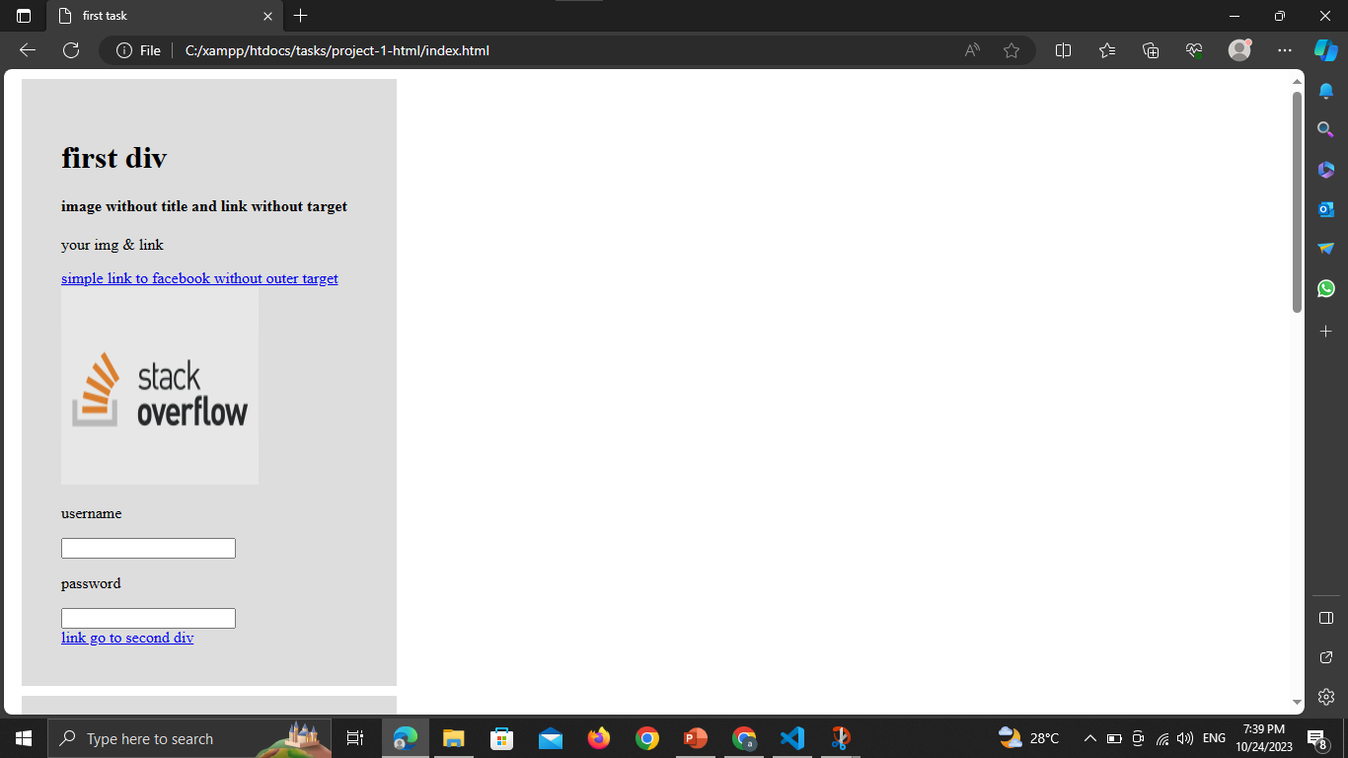

Slide 18


Slide 19
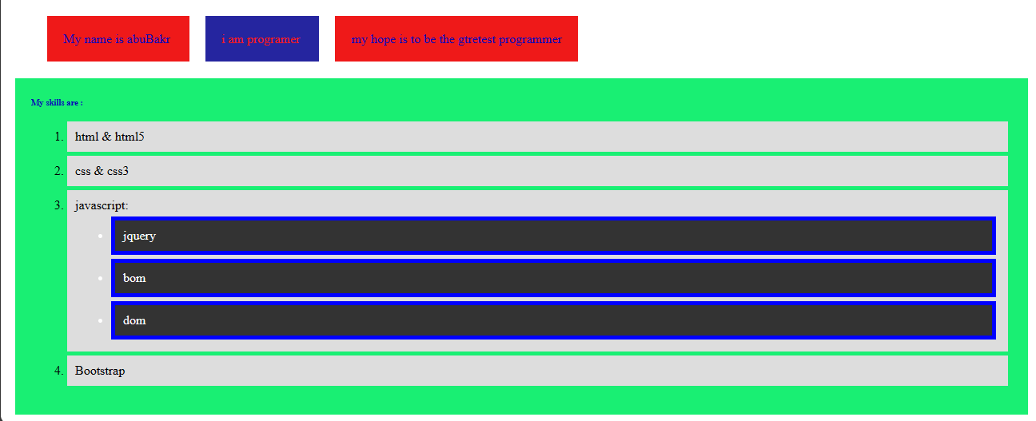
First Task

Slide 20


The End
in the end I hope you understood all I said contact on :
https://www.facebook.com/abobakr143
https://wa.me/201113284597

